Slide 1
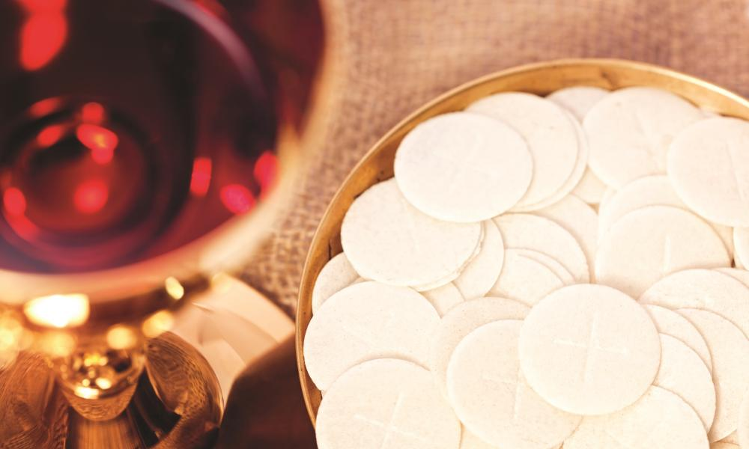


RE – EYFS and KS1
Eucharistic topic
A guide for parents

Slide 2
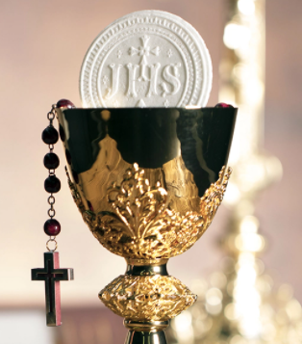
Outline
What will my child learn in the next RE topic?
How can I help them with their learning?
Key vocabulary and Scripture.
Some suggested activities to do
at home.

Slide 3
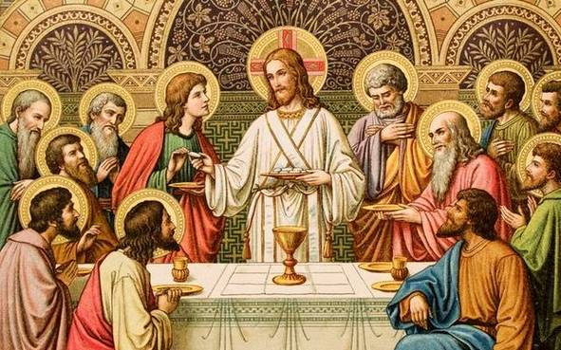
Outline for the whole school
Early Years: Gathering – the parish family gathers to celebrate the Eucharist.
Year 1: Meals – Mass, Jesus’s special meal
Year 2: Thanksgiving – Mass, a special time to thank God
Year 3: Listening and Sharing – Jesus gives himself to us
Year 4: Giving and Receiving – Living in Communion
Year 5 and 6: Unity – Eucharist enabling people to live in communion

Slide 4
Where can we watch a Mass?
Crawley Parish:
https://www.youtube.com/channel/UC5Plme089re79r4Z3QI2sSA?safe=true
Bexhill Parish:
https://www.youtube.com/channel/UCZo9NChKDnlb0RJuDBwwt7A
Guildford Parish:
https://www.youtube.com/c/CatholicParishofGuildford/videos
Arundel Cathedral:
https://www.youtube.com/channel/UC7I-pXF8v-VZfzO01zrnerQ/videos

Slide 5
Structure of RE Topics
Explore
Reveal
Respond

Slide 6
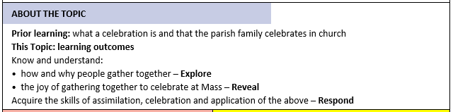
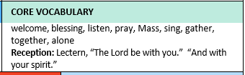
EYFS - Gathering
A Parish is a stable group of God’s people who have been grouped together often in a defined geographical area (such as Crawley). They have a Parish Priest who celebrates the Eucharist for and with them. A family is a place where we belong and are nurtured. We teach the children that by virtue of our baptism, we have become a child of God and so the Church should be a place where we feel we belong spiritually.

Slide 7
Structure of Gathering topic
Explore - How and why people gather together.
Reveal - The joy of gathering together to celebrate at Mass.
Respond - Remembering, celebrating and responding to how and why people gather together and the joy of gathering together to celebrate at Mass.

Slide 8
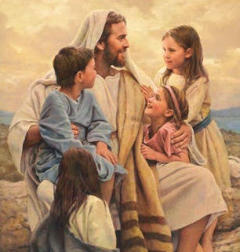
Key Scripture
Mark 10:13-16
Jesus Accepts Children
¹³ Some people brought their small children to Jesus so he could touch them. But his followers told the people to stop bringing their children to him. ¹⁴ When Jesus saw this, he was displeased. He said to them, “Let the little children come to me. Don’t stop them. The kingdom of God belongs to people who are like these little children. ¹⁵ I tell you the truth. You must accept the kingdom of God as a little child accepts things, or you will never enter it.” ¹⁶ Then Jesus took the children in his arms. He put his hands on them and blessed them.

Slide 9
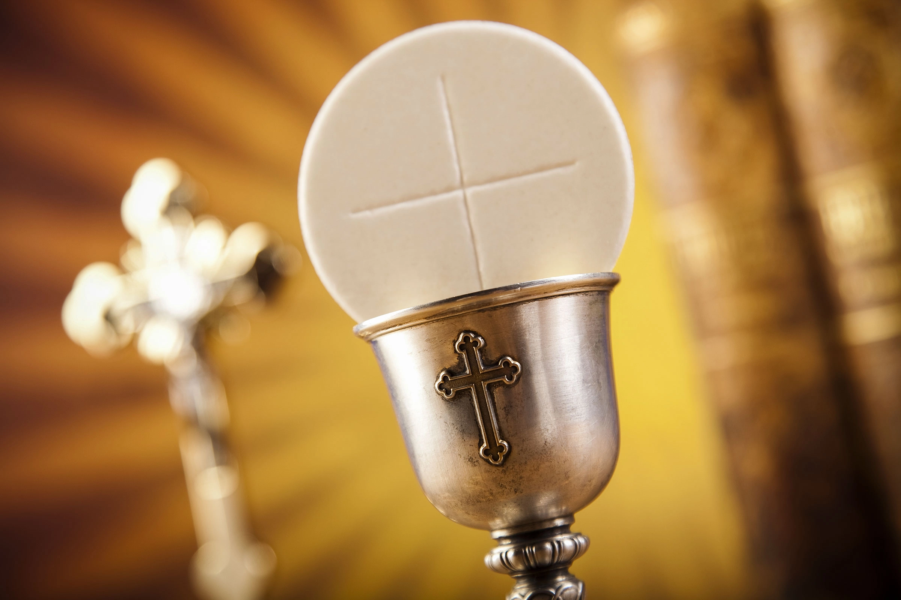
Some suggested activities
Make a poster or chart to show all of the activities that you do throughout the day/week as a family.
Find some pictures of gatherings that you have had as a family or with friends. Reflect on how you might have felt and why these moments are special.
Watch a Mass together and discuss how the Parish family gather together. Try to explain how the Parish family is similar to our own families.

Slide 10
Assessment
CHURCH TEACHING
This is an outline of the teaching of the Church covered in
GATHERING:
The parish family gathers for Mass.
Entering the church: the holy water font, the aisle and the benches where the people gather.
Ministries of welcoming and of serving at Mass.
Jesus gathered the children to speak to them (Mark 10).
Parts of the Mass
  gathering
  welcome
  listening to God’s Word
  receiving Jesus in Holy Communion.
Some children will begin to talk about the times they have gathered together with others. Some children will begin to talk about how they felt.
Some children will begin to say what they wonder about the enjoyment of being together.
Some children will begin to recognise the story of Jesus with the children as a religious story.
Some children will begin to recognise the phrases “The Lord be with you.” “And with your spirit.”
Some children will begin to recognise the Lectern and know how it is used.
Some children will begin to recognise how at Mass people gather to share the stories of God’s love.
Some children will begin to talk about their experience of visiting church and listening to God’s word.

Slide 11
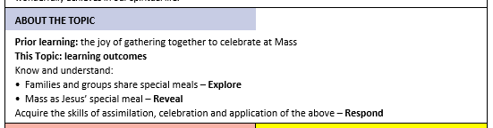

Year 1 - Meals
The Gospel shows how Jesus often met people in the context of a meal, in which is shared more than food. With Jesus it is often a parable (a teaching story). At mealtimes we share the hopes, joys, fears, and anxieties of the day, and in sharing this communion (from the word communicate) we grow as a person and as a community.

Slide 12
Structure of Meals topic
Explore - Families and groups share special meals.
Reveal - Mass as Jesus’ special meal.
Respond - Remembering, celebrating and responding to families and groups share special meals and Mass as Jesus’ special meal.

Slide 13
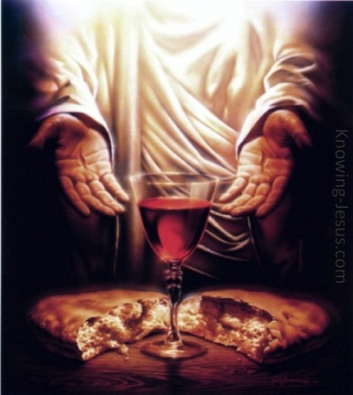
Key Scripture
Luke 22:19-20
The Last Supper
¹⁹ Then Jesus took some bread. He thanked God for it, broke it, and gave it to the apostles. Then Jesus said, “This bread is my body that I am giving for you. Do this to remember me.” ²⁰ In the same way, after supper, Jesus took the cup and said, “This cup shows the new agreement that God makes with his people. This new agreement begins with my blood which is poured out for you.”

Slide 14
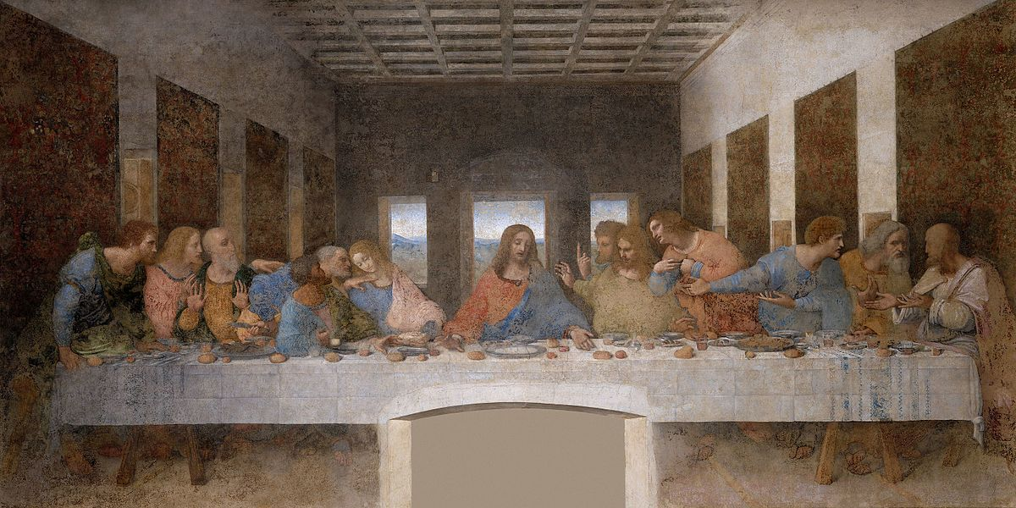
Some suggested activities
Plan a special meal for your household. Draw a picture of your meal and write about how it feels to gather with your family.
Read the story of the Last Supper and look at some paintings of it. Try to retell the story, remembering the words that Jesus said to his disciples.
Watch a Mass, listening especially to the Eucharistic prayer. Reflect on why the words that the Priest says are important.

Slide 15
Assessment
CHURCH TEACHING
This is an outline of the teaching of the Church covered in MEALS:
Catholics go to Mass on Sunday as members of God’s family.
At Mass the action and the words of the Last Supper are repeated.
The Preparation of the Gifts.
The words and meaning of the Consecration.
The Our Father.
Presence of Jesus in Holy Communion.
Acknowledgement that all good things come from God.
The importance of prayer: grace before meals.
Some children will be able to talk about their experience and feelings about meals which are special to them.
Some children will be able to say what they wonder about why people share special meals.
Some children will be able to recognise the story of Jesus’ special meal at the Last Supper.
Some children will begin to ask and respond to questions about meals which are special to them.
Some children will begin to retell the story of Jesus’ special meal, The Last Supper.
Some children will begin to use religious words to say what happens at Communion at Mass.

Slide 16
Year 2 - Thanksgiving
In the celebration of the Eucharist, the parish family gathers to give thanks to God. What do we ‘naturally’ give thanks for? Life, Family, Home and Food, to name but a few. All these good things are given to us by God, but he also sanctifies them, fills them with life, blesses them and bestows them upon us in a ‘supernatural’ (above the natural) way. These same simple necessities are given to us in a spiritual way:
New life of grace in Holy Baptism.
We are made part of the family of God, sharing in the life of the Blessed Trinity.
We discover Heaven is the Father’s House, and if we can call God Father, then heaven is our true home.
God continues to feed us by his Word and by the sacrament of Jesus’s body and blood.

Slide 17
Structure of Thanksgiving topic
Explore - Different ways to say thank you.
Reveal - The Eucharist: the parish family thanks God for Jesus.
Respond - Remembering, celebrating and responding to different ways to say thank you and the Eucharist: the Parish family thanks God for Jesus.

Slide 18
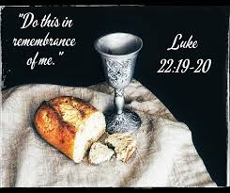
Key Scripture
Luke 22:19-20
The Last Supper
¹⁹ Then Jesus took some bread. He thanked God for it, broke it, and gave it to the apostles. Then Jesus said, “This bread is my body^{[a]} that I am giving for you. Do this to remember me.” ²⁰ In the same way, after supper, Jesus took the cup and said, “This cup shows the new agreement that God makes with his people. This new agreement begins with my blood which is poured out for you.”

Slide 19
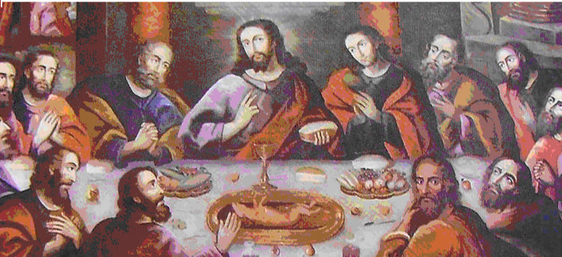
Some suggested activities
Write a prayer or hymn to show all of the things that you are thankful for.
Read the story of the Last Supper and begin to reflect on how the Disciples may have been feeling. Write a diary as if you were there.
Watch a Mass and try to identify the four parts of the Mass – Introductory (where we gather together), the Liturgy of the Word (where we listen to the Word of God), the Liturgy of the Eucharist (where the Priest says the Eucharistic prayer and we give thanks) and the Concluding Rite (where the Priest sends us out with a blessing).

Slide 20
Assessment
CHURCH TEACHING
This is an outline of the teaching of the Church covered in THANKSGIVING:
• Parts of the Mass – Introductory Rites, Liturgy of Word, Liturgy of Eucharist, Concluding Rites.
• Some Mass responses.
• Eucharistic Prayer for Children.
• Jesus’ presence in the Eucharist.
• The implication of the Concluding Rite of the Mass, where Catholics enter the world with a mission.
Some children will be able to talk about their experience of receiving and giving thanks.
Some children will be able to say what they wonder about how others feel when they are thanked.
Some children will be able to recognise the story of the Last Supper.
Some children will be able to recognise signs and symbols, different words and phrases used in the Eucharist (at Mass) to give thanks.
Some children will be able to recognise that Catholics go to Mass to remember what Jesus did at the Last Supper and give thanks to God.
Some children will be able to ask and respond to questions about how they and others feel when receiving and giving thanks.
Some children will be able to retell the story of the Last Supper.
Some children will be able to use words and phrases to describe some religious signs and symbols.
Some children will be able to use words and phrases to describe the steps involved in the Eucharist (Mass) showing how Catholics give thanks to God.
Some children will be able to describe how Catholics try to live what they have experienced at Mass in their daily lives.

Slide 21

Email: ploftus@olqoh.com

