Slide 1
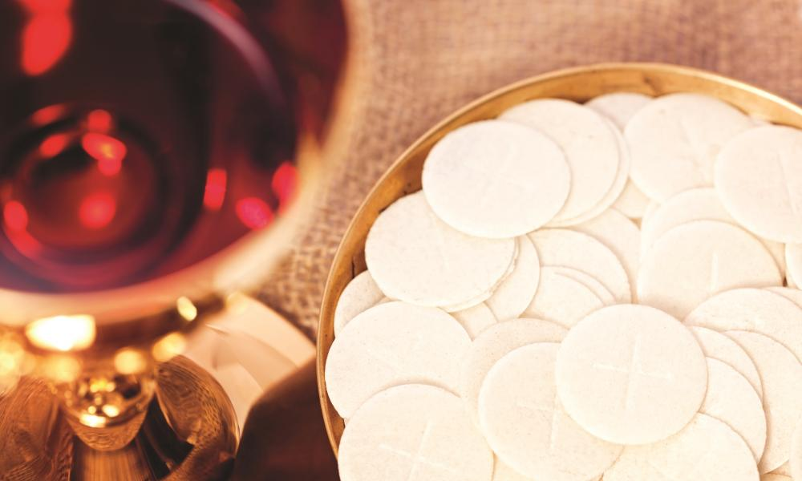


RE – KS2
Eucharistic topic
A guide for parents

Slide 2
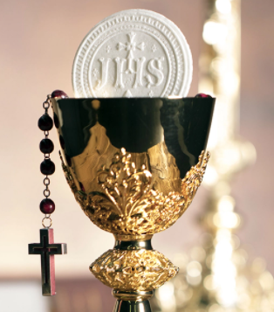
Outline
What will my child learn in the next RE topic?
How can I help them with their learning?
Glossary of key terms
Some suggested activities to do
at home.

Slide 3
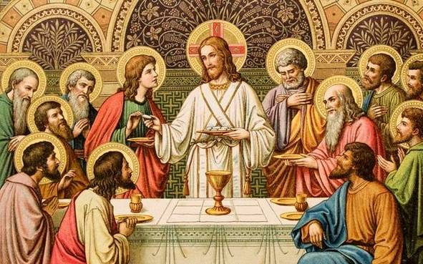
Outline for the whole school
Early Years: Gathering – the parish family gathers to celebrate the Eucharist.
Year 1: Meals – Mass, Jesus’s special meal
Year 2: Thanksgiving – Mass, a special time to thank God
Year 3: Listening and Sharing – Jesus gives himself to us
Year 4: Giving and Receiving – Living in Communion
Year 5: Memorial Sacrifice – Eucharist, the living memorial of Christ’s sacrifice
Year 6: Unity – Eucharist enabling people to live in communion

Slide 4
Where can we watch a Mass?
Crawley Parish:
https://www.youtube.com/channel/UC5Plme089re79r4Z3QI2sSA?safe=true
Bexhill Parish:
https://www.youtube.com/channel/UCZo9NChKDnlb0RJuDBwwt7A
Guildford Parish:
https://www.youtube.com/c/CatholicParishofGuildford/videos
Arundel Cathedral:
https://www.youtube.com/channel/UC7I-pXF8v-VZfzO01zrnerQ/videos

Slide 5
Structure of RE Topics
Explore
Reveal
Respond

Slide 6
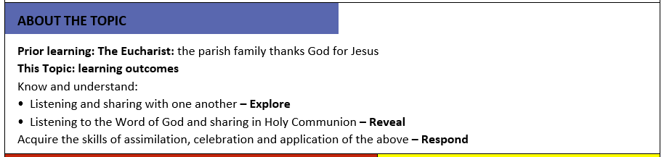
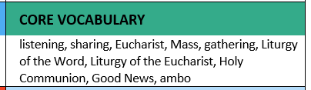
Year 3 – Listening and Sharing
In the Mass, Jesus nourishes us in Word and in Sacrament to strengthen us and make us Holy. ‘Man does not live by bread alone, but by every word that comes forth from the mouth of God’. John’s Gospel says Jesus is the ‘Word made flesh’ and who lives among us. Jesus was born in Bethlehem (which means House of Bread). In the Liturgy of the Word, we have been fed by his teaching and accounts of his life. Then in the Liturgy of the Eucharist we are fed his example and by his Body and Blood.

Slide 7
Structure of Listening and Sharing topic
Explore - Listening and sharing with one another.
Reveal - Listening to the Word of God and sharing in Holy Communion.
Respond - Remembering, celebrating and responding to listening and sharing with one another and listening to the Word of God and sharing in Holy Communion.

Slide 8
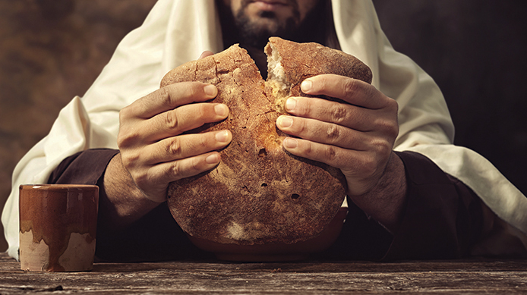
Key Scripture
Timothy 4:22
²² The Lord be with your spirit. Grace be with you.
John 6:35
³⁵ Then Jesus said, “I am the bread that gives life. He who comes to me will never be hungry. He who believes in me will never be thirsty.

Slide 9
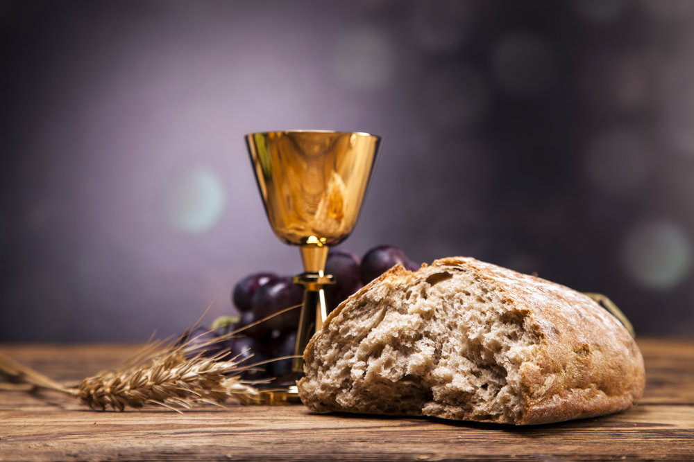
Some suggested activities
Research some local charities that help to provide food for those in need and promote sharing. Some examples of charities you could look at are ‘Giving back Crawley’ and the ‘SVP’.
Watch a Mass and role-play the liturgical elements of the gathering: Procession, the Sign of the Cross and welcome. Record it in some way and include a commentary to describe and give reasons for what is happening.
Try to learn the words to the Gloria and reflect on what the words mean.

Slide 10
Assessment
CHURCH TEACHING
This is an outline of the teaching of the Church covered in
LISTENING & SHARING:
The Introductory Rite
The Penitential Act.
The Gloria.
Liturgy of the Word.
The Gospel is the Good News.
God speaks to us through the scriptures.
The Creed.
The Liturgy of the Eucharist.
Preparation of the Gifts.
The Eucharistic Prayer.
Transubstantiation.
The Communion Rite.
The Concluding Rite.
Sending forth.
The responses of the Mass.
Some children will be able to ask and respond to questions about their own and others’ experiences and feelings about listening well and sharing.
Some children will be able to ask questions about what they and others wonder about the joys and difficulties of listening and sharing and realise that some of these questions are difficult to answer.
Some children will be able to use religious words and phrases to describe the actions and symbols used during the celebration of the Eucharist.
Some children will be able to describe some ways in which Christians share God’s love with others.
Some children will begin to make links to show how feelings and beliefs affect their own and others’ desire to listen and to share.
Some children will begin to compare their own and others’ ideas about the questions of how and why we listen and share and that these questions are difficult to answer.
Some children will begin to use a developing religious vocabulary to give reasons for specific actions and words used during the celebration of the Eucharist.
Some children will begin to give reasons why Christians want to share the Good News of Jesus.

Slide 11
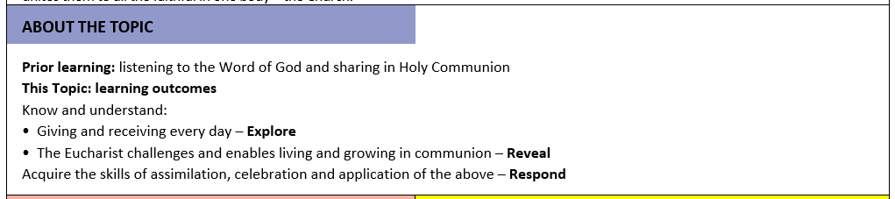
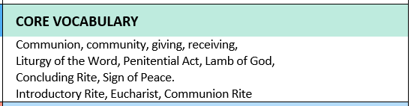
Year 4 – Giving and Receiving
The communion we share is universal, the Eucharist we share in Crawley is the same as in London, Rome, New York etc: ‘you never cease to gather a people to yourself, so that from the rising of the sun to its setting a pure sacrifice may be offered to your name”. There is an exchange, all be it unequal, between Heaven and Earth. The bread and wine are made holy by the descent of the Holy Spirit upon them like the dew fall and they become for us the body and blood of Our Lord Jesus Christ.

Slide 12
Structure of Giving and receiving topic
Explore - Giving and receiving every day.
Reveal - The Eucharist challenges and enables living and growing in communion.
Respond - Remembering, celebrating and responding to giving and receiving every day and that the Eucharist challenges and enables living and growing in communion.

Slide 13
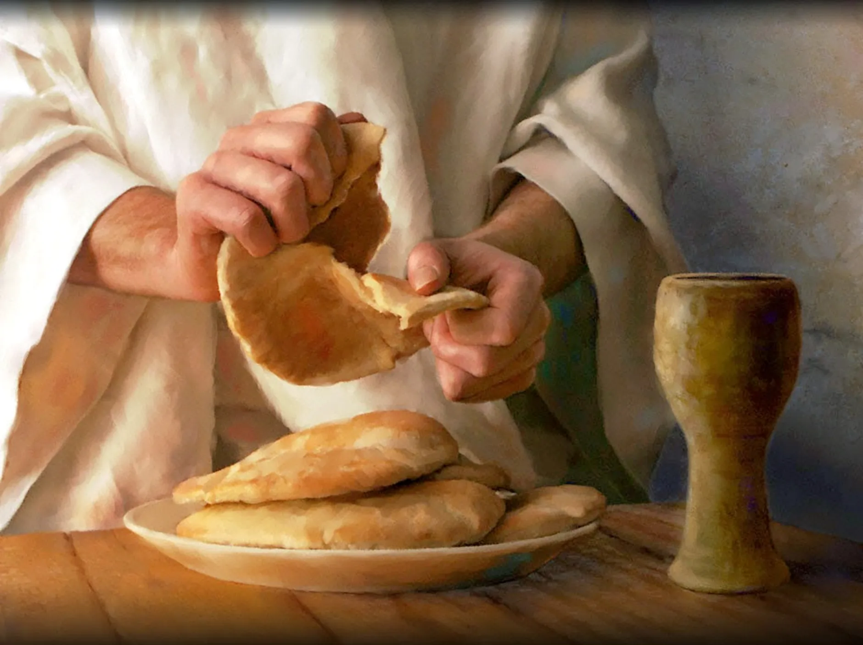
Key Scripture
Matthew 5: 45-48
⁴⁵ If you do this, then you will be true sons of your Father in heaven. Your Father causes the sun to rise on good people and on bad people. Your Father sends rain to those who do good and to those who do wrong. ⁴⁶ If you love only the people who love you, then you will get no reward. Even the tax collectors do that. ⁴⁷ And if you are nice only to your friends, then you are no better than other people. Even people without God are nice to their friends. ⁴⁸ So you must be perfect, just as your Father in heaven is perfect.
1 Corinthians 11: 24-27
²⁴ and gave thanks for it. Then he broke the bread and said, “This is my body; it is for you. Do this to remember me.” ²⁵ In the same way, after they ate, Jesus took the cup. He said, “This cup shows the new agreement from God to his people. This new agreement begins with the blood of my death. When you drink this, do it to remember me.” ²⁶ Every time you eat this bread and drink this cup, you show others about the Lord’s death until he comes.
²⁷ So a person should not eat the bread or drink the cup of the Lord in a way that is not worthy of it. If he does he is sinning against the body and the blood of the Lord.
Romans 12: 8-11
⁸ If one has the gift of encouraging others, he should encourage. If one has the gift of giving to others, he should give freely. If one has the gift of being a leader, he should try hard when he leads. If one has the gift of showing kindness to others, that person should do so with joy.
⁹ Your love must be real. Hate what is evil. Hold on to what is good. ¹⁰ Love each other like brothers and sisters. Give your brothers and sisters more honour than you want for yourselves. ¹¹ Do not be lazy but work hard. Serve the Lord with all your heart.

Slide 14
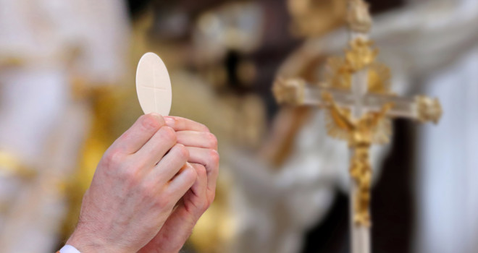
Some suggested activities
After listening to, or having read the words of some gathering hymns: e.g. Here in this place, Bernadette Farrell. John Burland’s Gather together, write an additional verse to the hymn or try to write your own hymn.
Watch a Mass and write an account of what happens at the gathering of the Eucharist. Begin to reflect on some of the actions and words of the Priest.
Design a ‘Charter to Live By’ based on Matthew 5: 45-58, making links between the Scripture and how we might lead our lives.

Slide 15
Assessment
CHURCH TEACHING
This is an outline of the teaching of the Church covered in GIVING AND RECEIVING:
Introductory Rites.
Penitential Act.
Communion Rite.
The Lord’s Prayer.
The Sign of Peace.
Lamb of God.
Holy Communion.
Transubstantiation.
Prayer after Communion.
Concluding Rite.
Some children will be able to ask and respond to their own and others’ experiences and feelings about giving and receiving.
Some children will be able to ask questions about what they and others wonder about giving and receiving every day and realise that some of these questions are difficult to answer.
Some children will be able to describe what happens during the Introductory Rite.
Some children will be able to describe what a person might do if they follow Jesus’ advice.
Some children will be able to describe ways in which peace is lived out by believers.
Some children will be able to make links to show how feelings and beliefs about giving and receiving affects their own behaviour and that of others.
Some children will be able to compare their own and other people’s ideas about questions of giving and receiving that are difficult to answer.
Some children will be able to make links between scripture and an understanding of the Eucharist.
Some children will be able to use a developing religious vocabulary to give reasons for religious actions and symbols used in the celebration of the Eucharist.
Some children will be able to give reasons why Christians attend the celebration of the Eucharist.

Slide 16
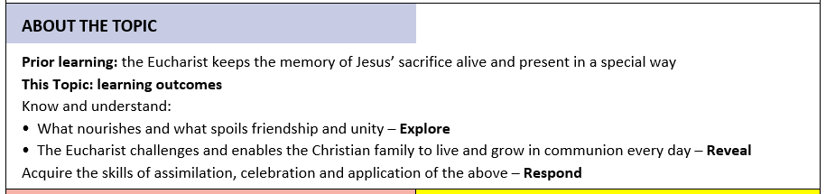
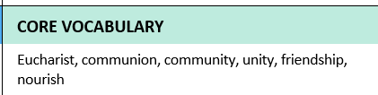
Year 5 and 6 – Unity
The Holy Mass is the place where we gather to celebrate the Eucharist and we do so most especially on the Lord’s Day which is Sunday, the day of the Resurrection. In the Holy Mass, the Church on earth is united with the Church triumphant in heaven. It is the place where heaven and earth touch, and we cry out with all the angels and saints:
‘Holy, Holy, Holy Lord God of Hosts, heaven and earth are full of your glory, hosanna in the highest’.

Slide 17
Structure of Unity topic
Explore -What nourishes and what spoils friendship and unity.
Reveal - The Eucharist challenges and enables the Christian family to live and grow in communion every day.
Respond -Remembering, celebrating and responding to the experience of what nourishes and what spoils friendship and unity and that the Eucharist challenges and enables the Christian family to live and grow in communion every day.

Slide 18
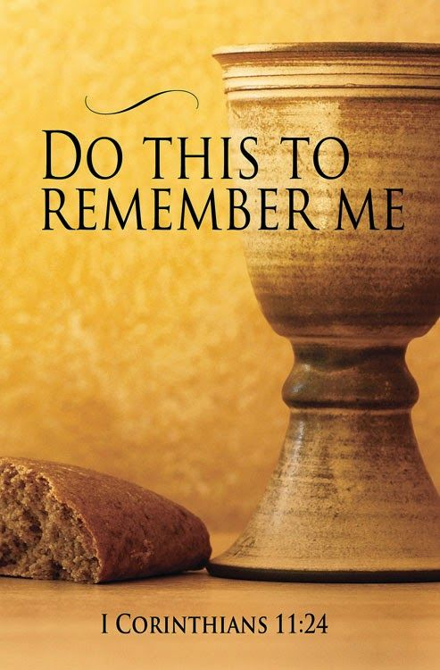
Key Scripture
Matthew 6:9-15
⁹ So when you pray, you should pray like this: ‘Our Father in heaven, we pray that your name will always be kept holy. ¹⁰ We pray that your kingdom will come. We pray that what you want will be done, here on earth as it is in heaven. ¹¹ Give us the food we need for each day. ¹² Forgive the sins we have done, just as we have forgiven those who did wrong to us. ¹³ And do not cause us to be tested; but save us from the Evil One.’
John 17:11,20-23
¹¹ Now I am coming to you. I will not stay in the world now. But these men are still in the world. Holy Father, keep them safe. Keep them safe by the power of your name (the name you gave me), so that they will be one, the same as you and I are one.
²⁰ “I pray for these men. But I am also praying for all people who will believe in me because of the teaching of these men. ²¹ Father, I pray that all people who believe in me can be one. You are in me and I am in you. I pray that these people can also be one in us, so that the world will believe that you sent me. ²² I have given these people the glory that you gave me. I gave them this glory so that they can be one, the same as you and I are one. ²³ I will be in them and you will be in me. So they will be completely one. Then the world will know that you sent me. And the world will know that you loved these people the same as you loved me.
1 Corinthians 10:17
¹⁷ There is one loaf of bread. And we are many people. But we all share from that one loaf. So we are really one body.

Slide 19
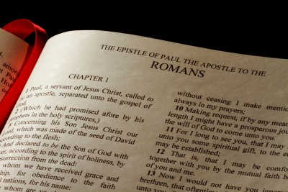
Key Scripture
Romans 12: 3-10
³ God has given me a special gift. That is why I have something to say to everyone among you. Do not think that you are better than you are. You must see yourself as you really are. Decide what you are by the amount of faith God has given you. ⁴ Each one of us has a body, and that body has many parts. These parts all have different uses. ⁵ In the same way, we are many, but in Christ we are all one body. Each one is a part of that body. And each part belongs to all the other parts. ⁶ We all have different gifts. Each gift came because of the grace that God gave us. If one has the gift of prophecy, he should use that gift with the faith he has. ⁷ If one has the gift of serving, he should serve. If one has the gift of teaching, he should teach. ⁸ If one has the gift of encouraging others, he should encourage. If one has the gift of giving to others, he should give freely. If one has the gift of being a leader, he should try hard when he leads. If one has the gift of showing kindness to others, that person should do so with joy.
⁹ Your love must be real. Hate what is evil. Hold on to what is good. ¹⁰ Love each other like brothers and sisters. Give your brothers and sisters more honour than you want for yourselves.
1 Corinthians 12:12-13
¹² A person’s body is one thing, but it has many parts. Yes, there are many parts to a body, but all those parts make only one body. Christ is like that too. ¹³ Some of us are Jews, and some of us are Greeks. Some of us are slaves, and some of us are free. But we were all baptized into one body through one Spirit. And we were all made to share in the one Spirit.

Slide 20
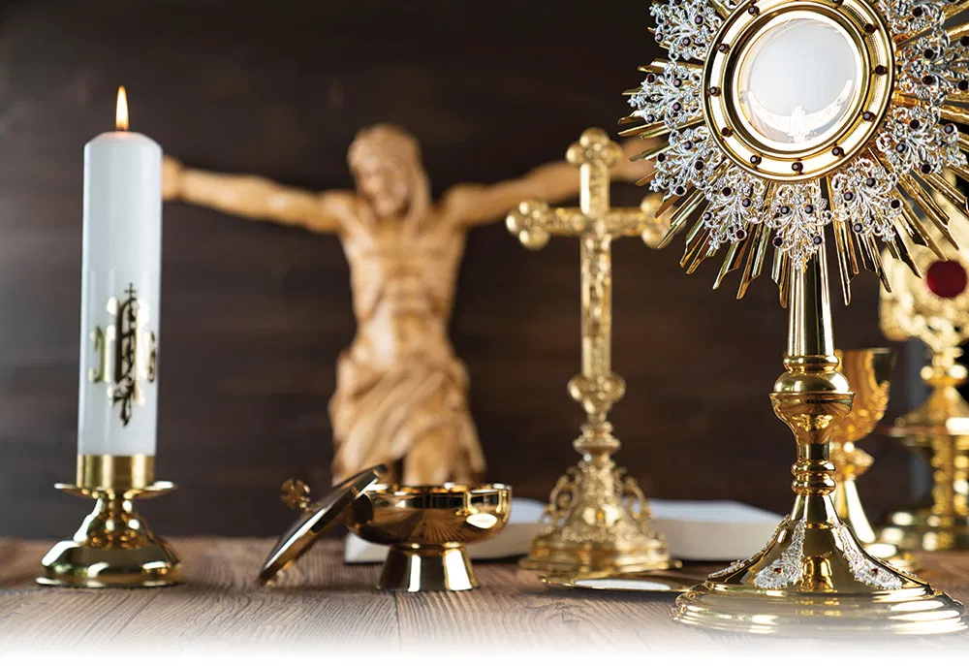
Some suggested activities
Using what you believe and value, create a Code of Conduct showing what makes a good friend. Give reasons for your choice of statements.
Use the text from John and compose a prayer for unity.
Watch a Mass, focus on the Eucharistic prayer and try to join in with the responses. Pick out your favourite phrases used in the prayer.

Slide 21
Assessment
Some children will be able to make links to show how feelings and beliefs about what makes, and breaks friendship and unity affects their behaviour and that of others.
Some children will be able to ask and respond to questions about their own and others’ experiences and feelings about friendship and unity.
Some children will be able to compare their own and other people’s ideas about questions concerning friendship which are difficult to answer.
Some children will be able to make links between scripture and the Eucharist.
Some children will be able to use a developing religious vocabulary to give reasons for the actions and symbols of the Communion Rite.
Some children will be able to give reasons why Christians gather together in ‘communion’ and receive ‘Holy Communion’.
Some children will be able to show how their own and others’ decisions about friendships are informed by beliefs and values.
Some children will be able to show understanding of the links between a range of Scripture texts and some parts of the Mass which express communion with Jesus and the feelings that communion with others brings.
Some children will be able to use religious terms to show an understanding of different aspects of the Eucharist.
Some children will be able to show understanding of how belief in Jesus Christ, the uniting presence in Holy Communion, shapes the lives of Christians.
CHURCH TEACHING
This is an outline of the teaching of the Church covered in UNITY:
Jesus’ priestly prayer for unity in John 17.
One body in union with Christ.
Eucharistic Prayer for Children III.
The Communion Rite.
The unity of the Church in Heaven and on earth with the offering of Christ.
Our Father.
The prayer for peace and unity.
Sign of Peace.
Lamb of God.
The prayer: Lord, I am not worthy.
The Eucharistic presence of Christ.
Reception of Christ in Holy Communion and union of the faithful.

Slide 22

Email: ploftus@olqoh.com

